Slide 1

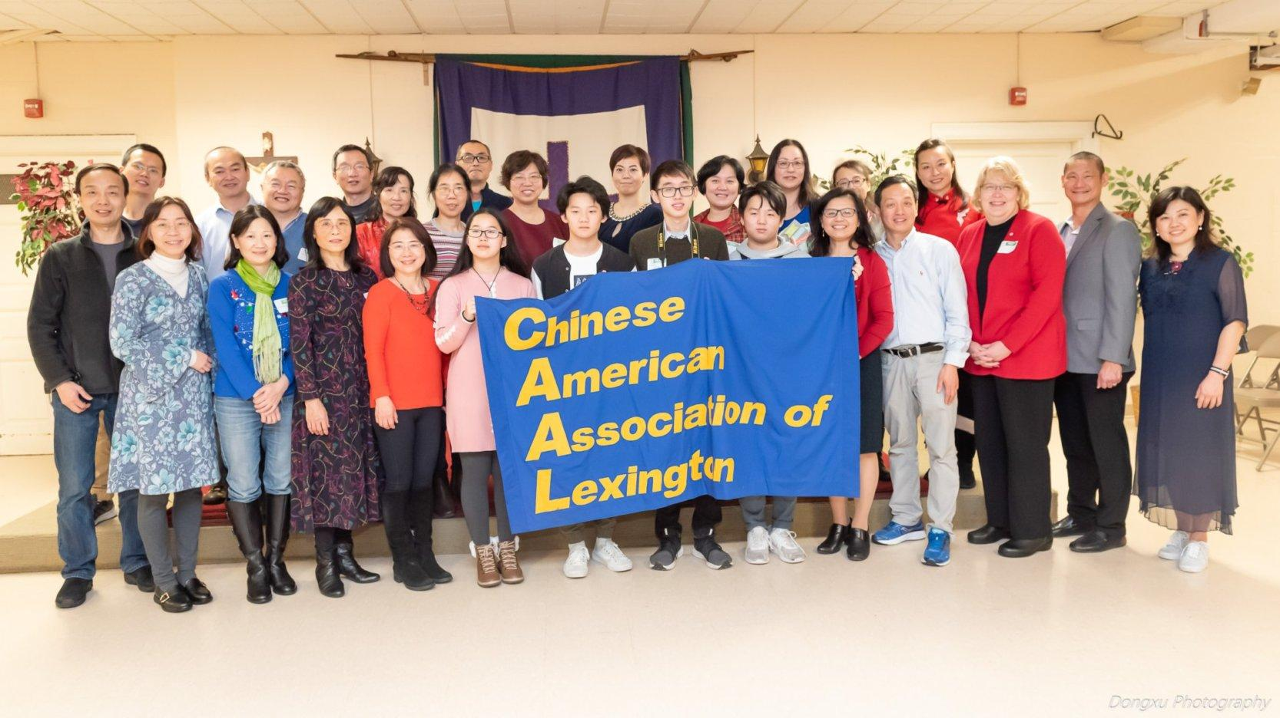
CAAL Introduction

Slide 2
Mission
To serve Lexington and Chinese American community in town affairs and community activities, especially public-school education, civic engagement, and cultural sharing.
To provide opportunities for Chinese Americans to engage with the Lexington community through volunteerism, networking, and social events

Slide 3
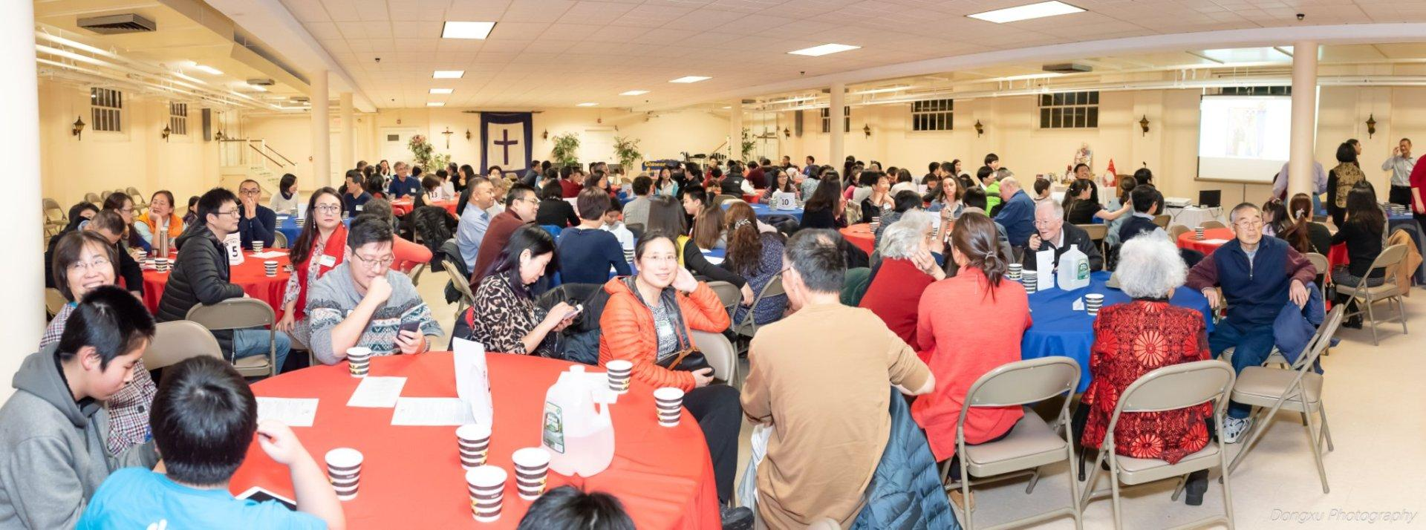

Slide 4
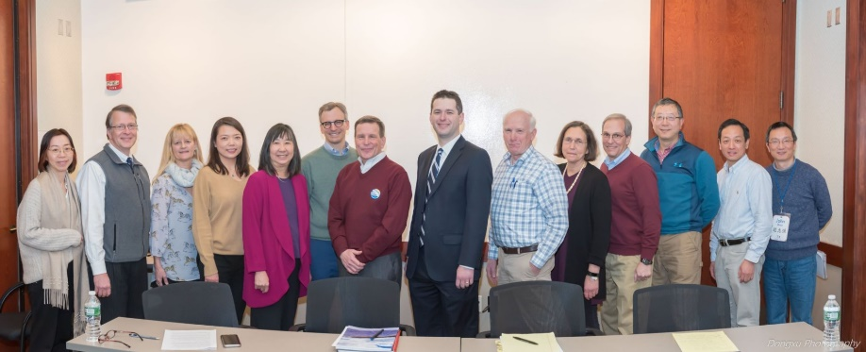
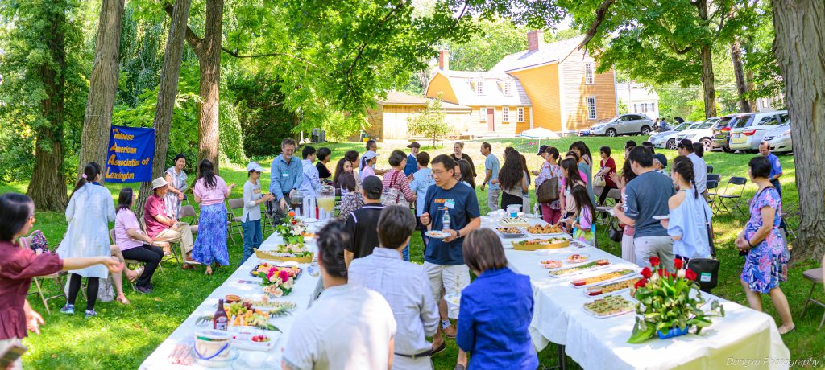
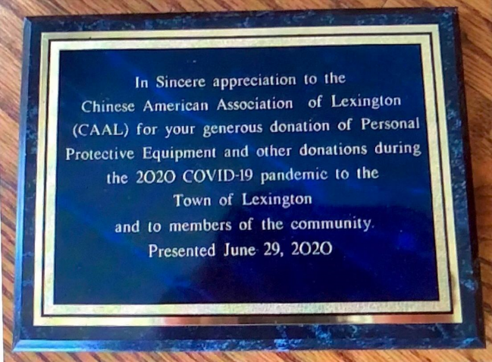
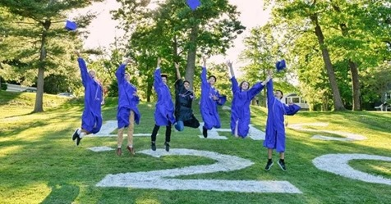
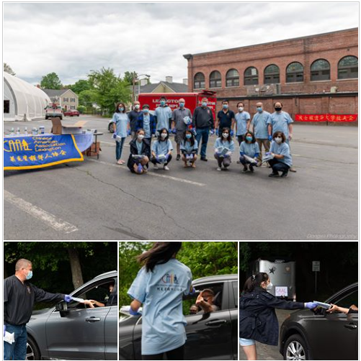
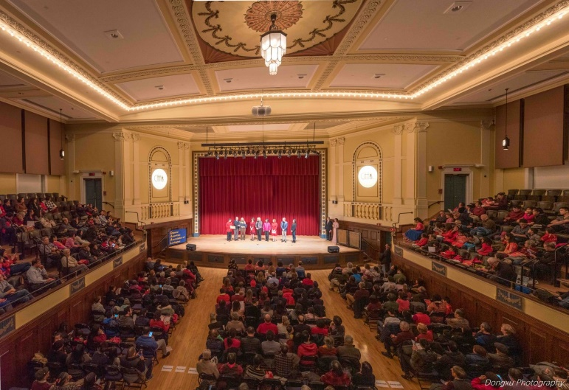
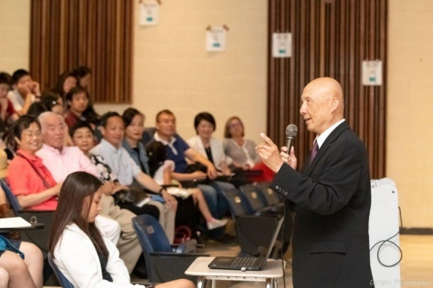
Get Involved, Give Back to Our Community!
Make a difference to Civic Life
CAAL is recognized by the town for its over $280K COVID-19 humanitarian relief campaign
Provide Social Networking
Support School and Education
Provide Community Service Platforms
Share Chinese Culture
Advance Social Justice and Equity

Slide 5
History
CAAL has been serving Chinese American community in Lexington since the 1983. With the influx of Chinese families to town in recent years, CAAL has worked to increase our social and political profile in the community.
CAAL has been increasingly involved in many aspects of town affairs, including elected Town Meeting, town-wide officials, elected Board representation and participated in various town committees.
In 2011, the CAAL Community Task Force (CTF) was founded to advance civic involvement.
In 2013, CAAL became a recognized tax-exempt organization under Section 501(c)(3).
In early 2017, the CAAL Political Action Committee (PAC) was created as a separate entity to focus on civic affairs and local elections.

Slide 6
Committees
Executive Committee Elected and appointed members work to set the overall direction of CAAL; They establish the annual budget, supervise spending, and lead monthly meetings. Committees Civil Engagement Committee (formerly known as Community Task Force) Coordinates civic-related activities with the focus on increasing Chinese American participation at town-wide elections Education Committee (EdCAAL) Organizes events on school-related topics and promote volunteering in schools and parent-teacher organizations Community Services Committee Organizes volunteers for CAAL organized or supported events; Oversee youth programs and administers our Presidential Volunteer Service Award Culture Committee Plans events to promote Chinese culture, advocate diversity, and foster cultural exchange Communication and Outreach committee Promote Lexington and CAAL events in bilingual and bridge between Lexington and Chinese American Community

Slide 7
Impact and Accomplishments
With the rapid influx of Chinese families, CAAL has doubled its efforts to work with the town, the school system, and community organizations.
Most recently, CAAL has undertaken an epic $280,000 Covid relief campaign for the Lexington community and beyond. CAAL was also known for its massive "CAAL for Cary fundraising of $75,000".

Slide 8
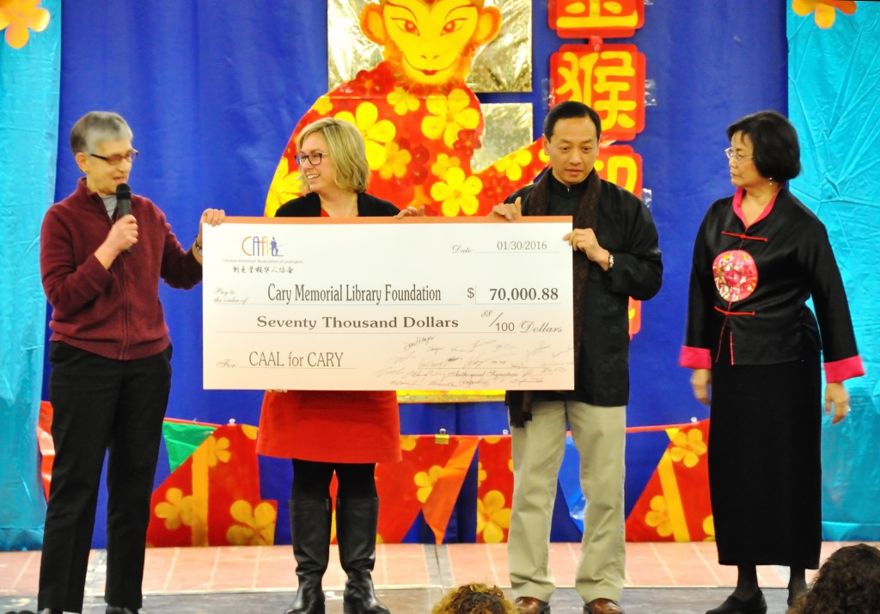
CAAL for Cary Fundraising

Slide 9
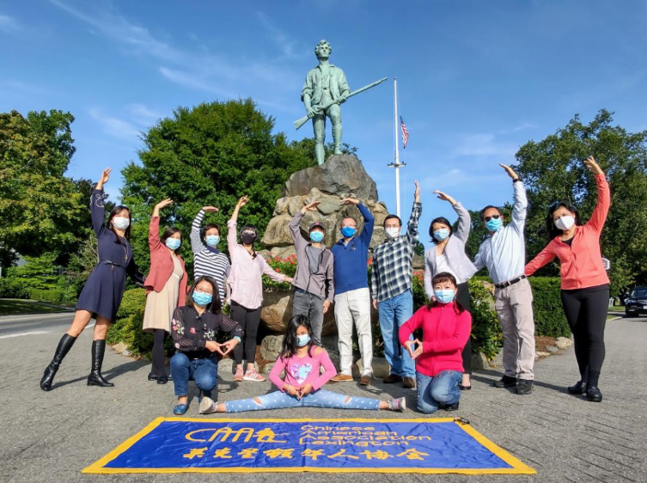
COVID relief campaign raising $280K

Slide 10
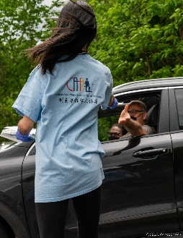
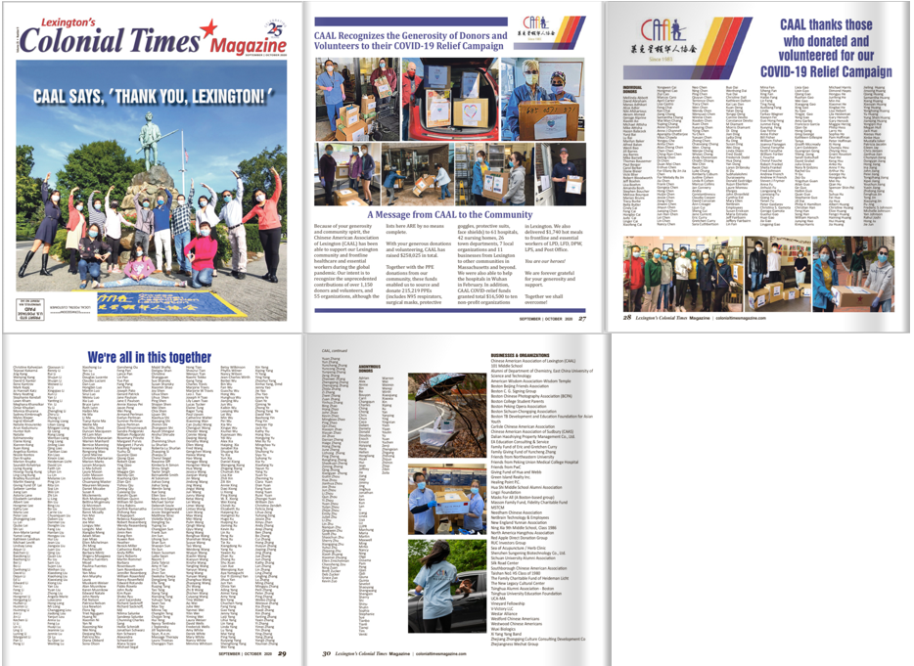
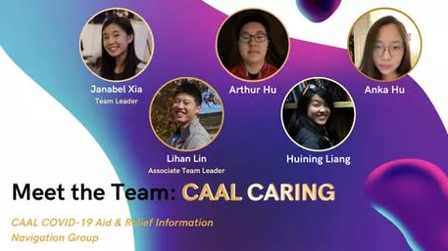
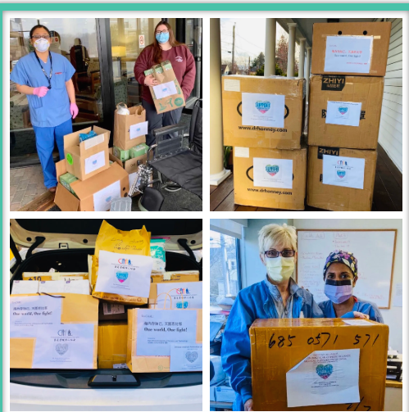
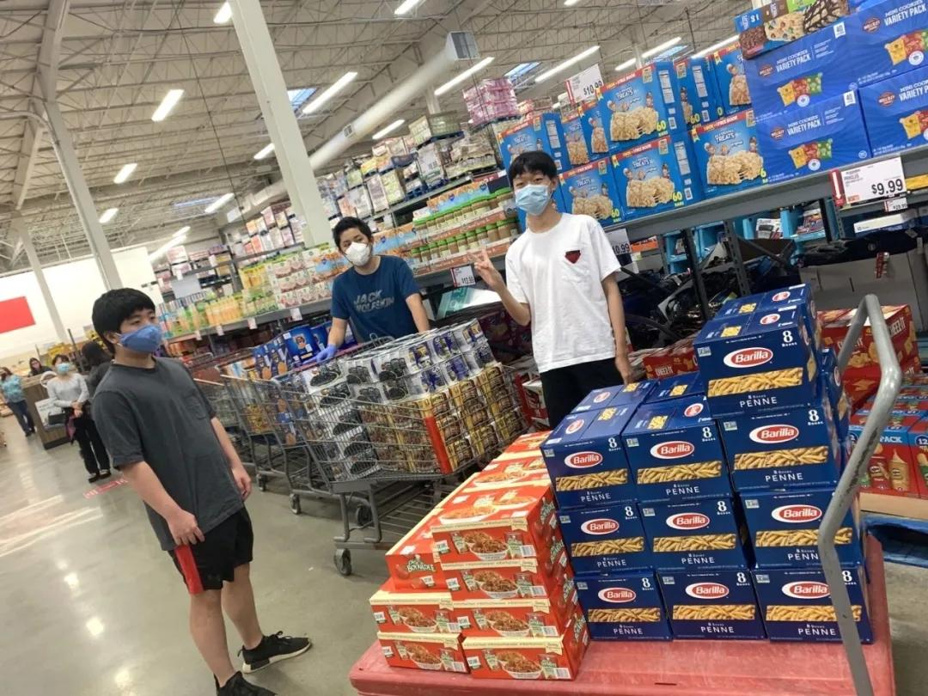
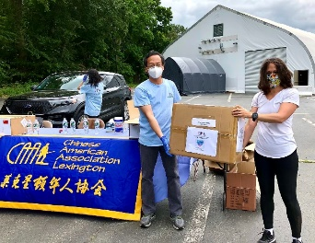
Recognize 1,150 donors, volunteers and 55 organizations for
Our COVID Relief Campaign

Slide 11

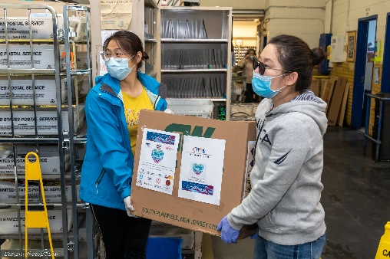
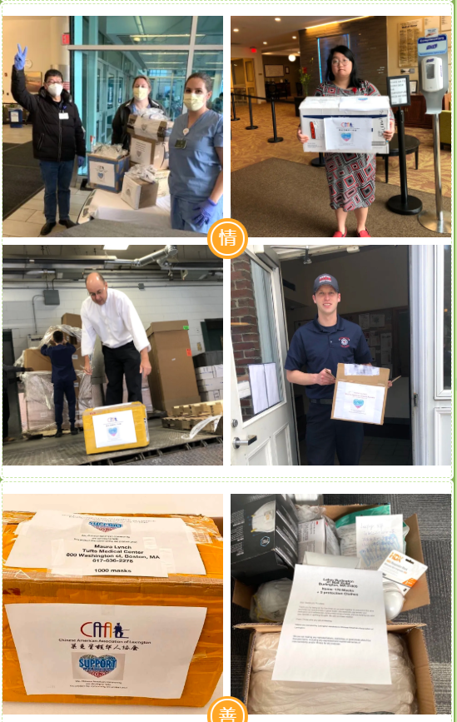
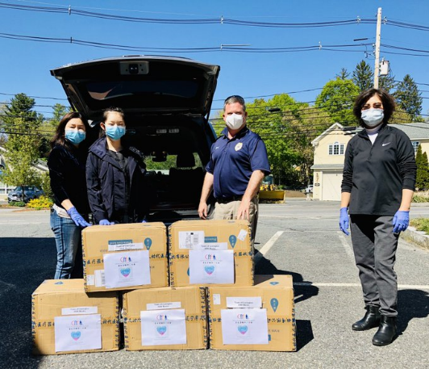
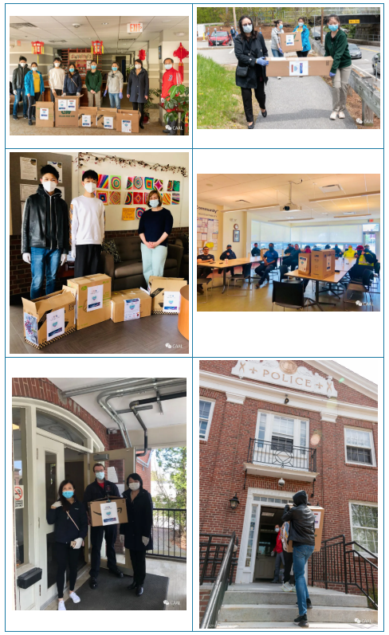
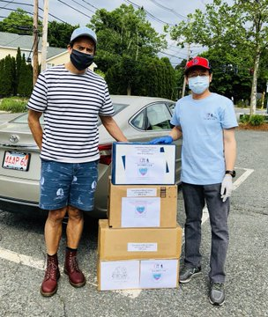
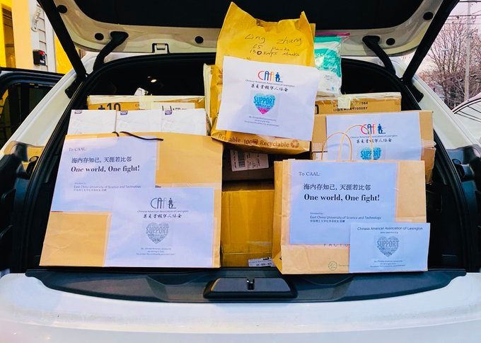
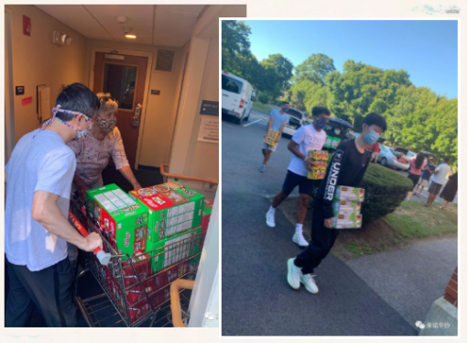
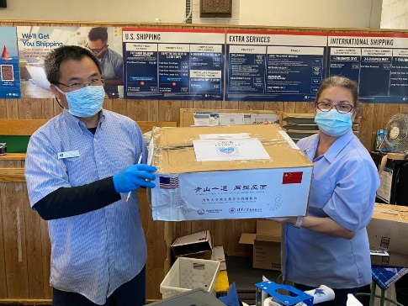
We Are in This Together!

Slide 12
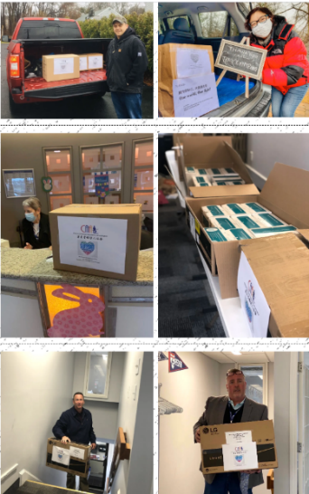
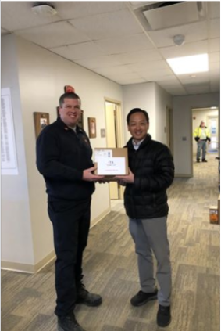
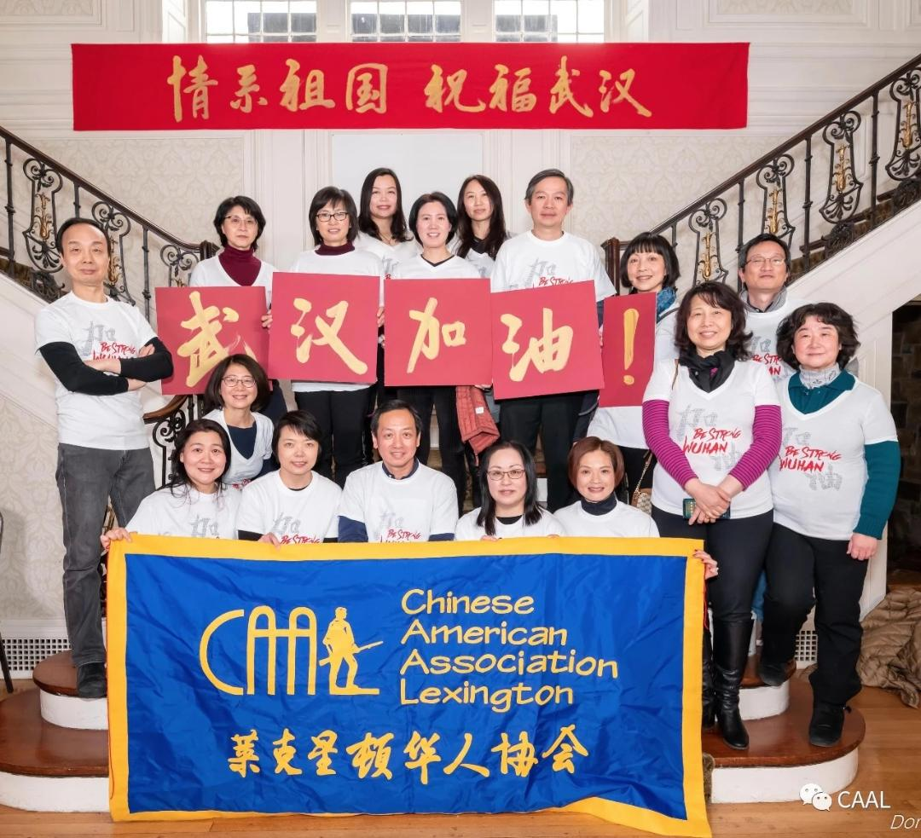
CAAL COVID-19 Relief Campaign Summary
316,352
Includes
N95 respirators surgical masks protective goggles protective suits face shields
DIY masks
$278,025
Support Communities
Support China
PPE Donations
Fundraising
Food of Love
61 hospitals
42 nursing homes
26 town departments
7 local orgs 11 businesses
Mask Pick-up Station
(from Lexington to other communities in MA and beyond)
174 hot meals
To frontline, essential workers:
LPD
LFD
DPW
LPS
Post Office
Supported over 40 hospitals in Wuhan and other cities in February 2020

Slide 13
CAAL COVID-19 Relief Program
Supported 19 Local Organizations and Projects with over $ 33,691
CAAL 2020 Community Building Award
Lexington Interfaith Food Pantry
$5,000
Sponsor a Basket Youth Program
Lexington Interfaith Food Pantry
$3,000
LexGetScreen Matching Campaign
Lexington Education Foundation (LEF)
Lexington Public Schools
Matching $5,000; Total raised $10,691
CAAL Relief Program Recipients ($1,000 each)
Munroe Center for the Arts
Munroe Center Donation Match
Neighbor Brigade
Lexington Symphony
Lexington Arts And Crafts Society, Inc. (LexArt)
Lexington Historical Society
Lexington Community Farm Coalition (LexFarm)
METCO College Scholarship Fund of Lexington
New Legacy Cultural Center
Lexington Farmer’s Market
LHS PTO for COVID Based Equipment Campaign
Cary Library Digital Content
Community Endowment of Lexington (CEL)
Art Walk
Community DIY Mask Project ($500)
Helpful Hands (Youth DYI Mask Project) ($500)

Slide 14
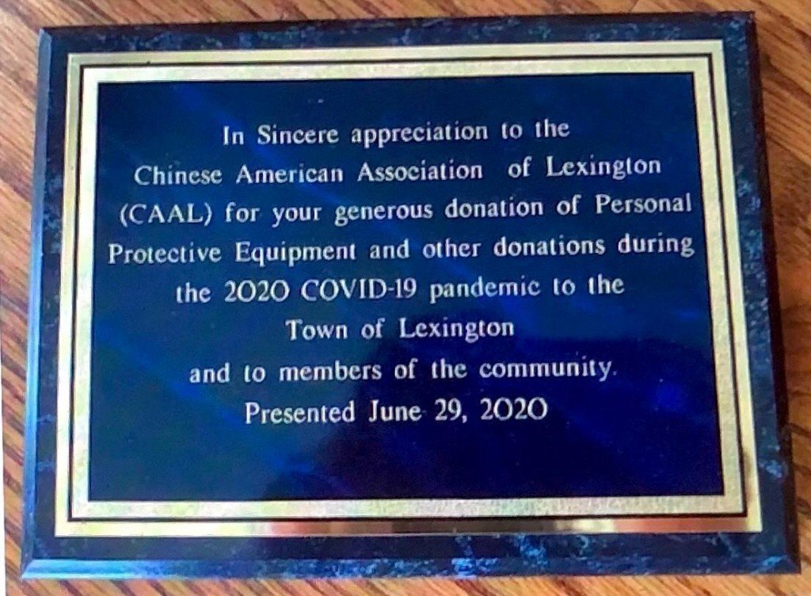
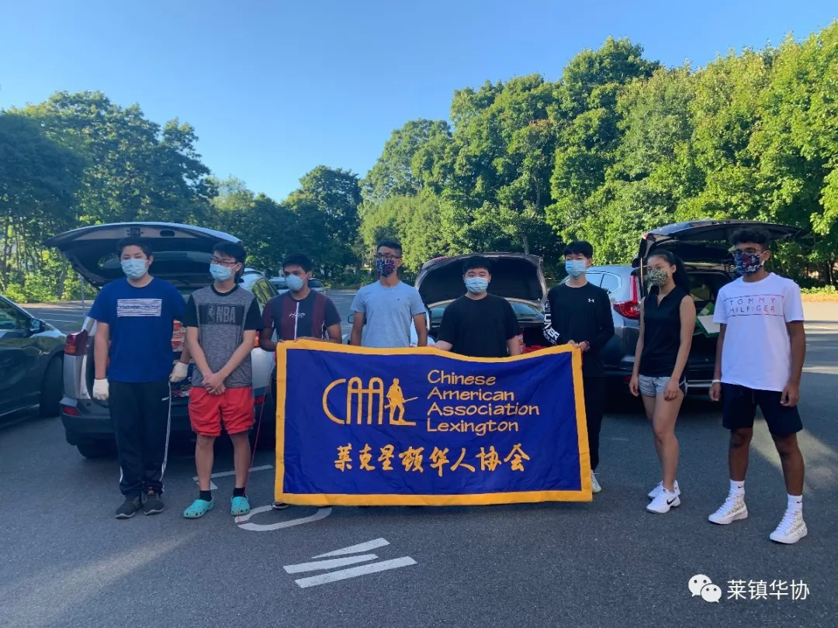
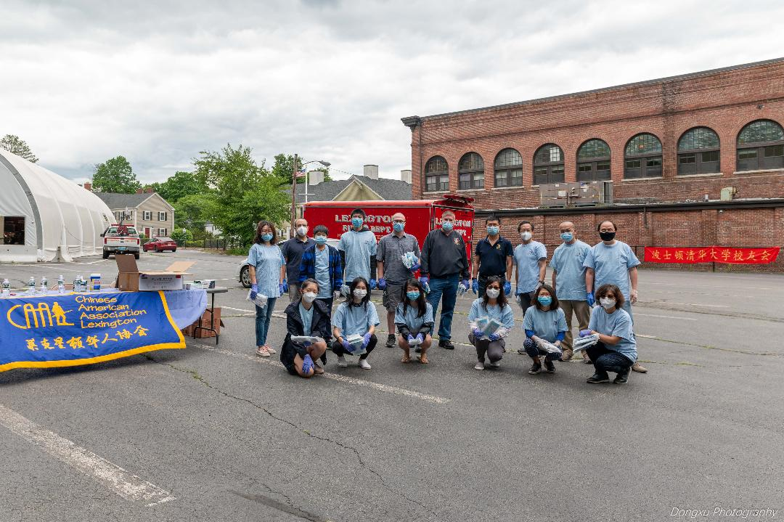
Town Recognition
We are forever grateful to the generosity and support from the community!
You are our heroes!
Together we shall overcome!

Slide 15
CAAL Traditions of Decades
Among the many events, CAAL organized, the Lunar New Year celebration has been our tradition for decades. Known as the best party in town, it draws hundreds of in-person participants and thousands of online audiences.
CAAL's other tradition includes the Candidate Forum where we invite town-wide candidates to meet with the community. CAAL continues to encourage Chinese Americans to participate in town government and civic activities. More and more Chinese Americans are stepping up to run Town Meeting and participating in various town committees. As of 2022, there are 16 Chinese American Town Meeting members, and 30 Chinese Americans joined various town committees.

Slide 16
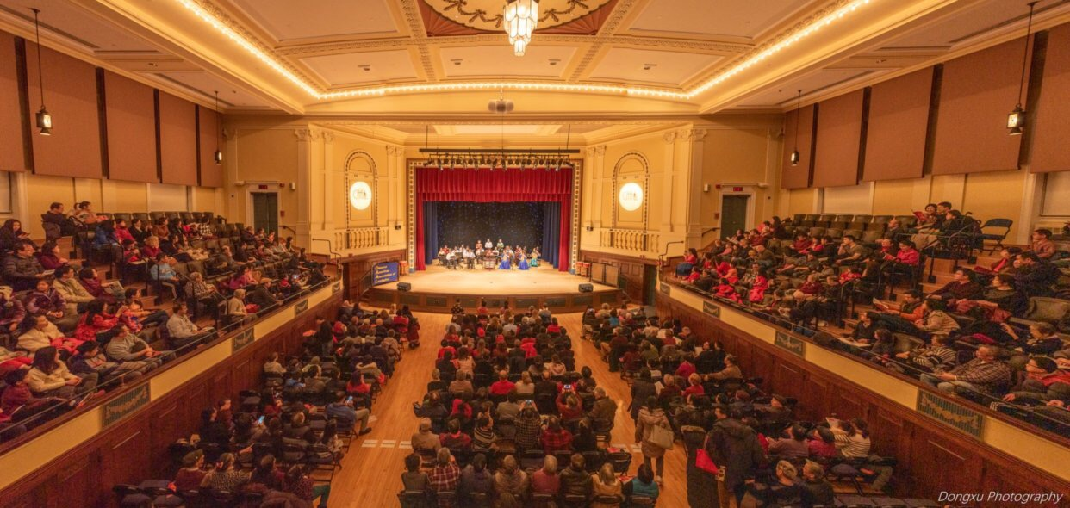
Lunar New Year Celebration in Cary Hall

Slide 17
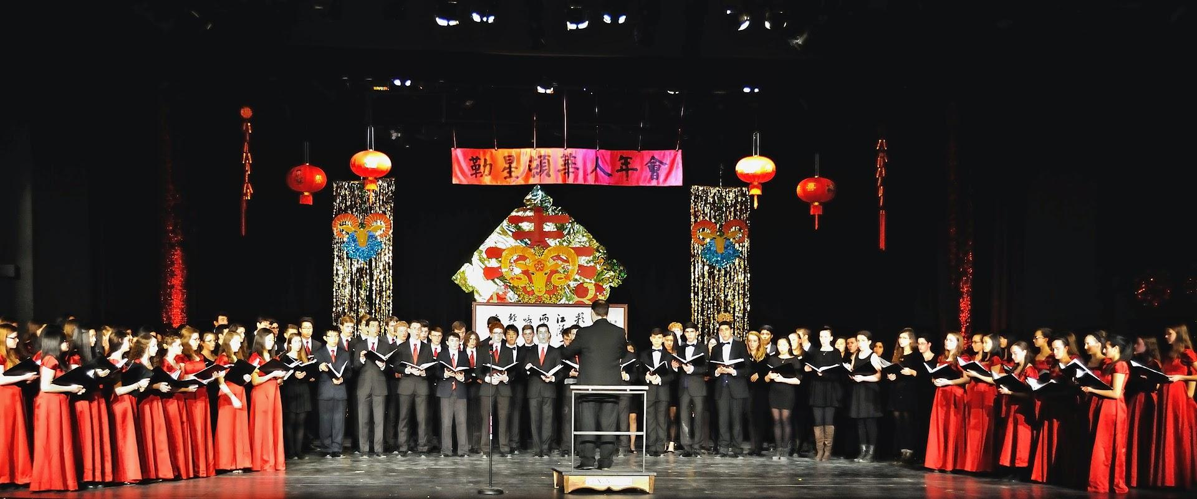
Lunar New Year Celebration in LHS Auditorium

Slide 18
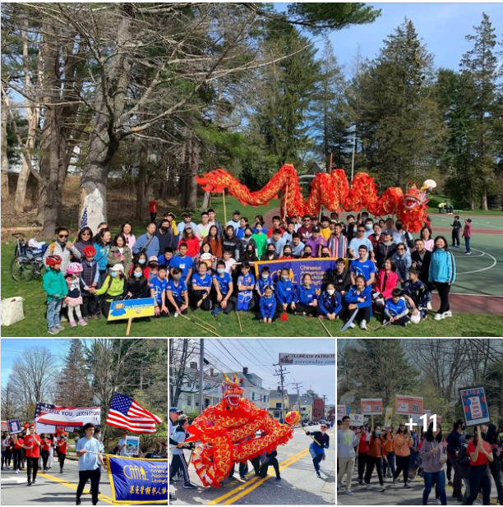
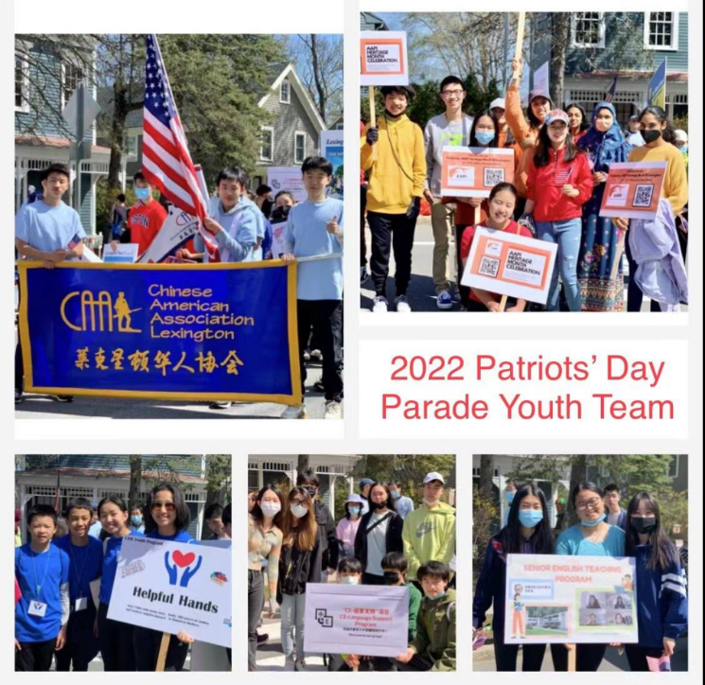
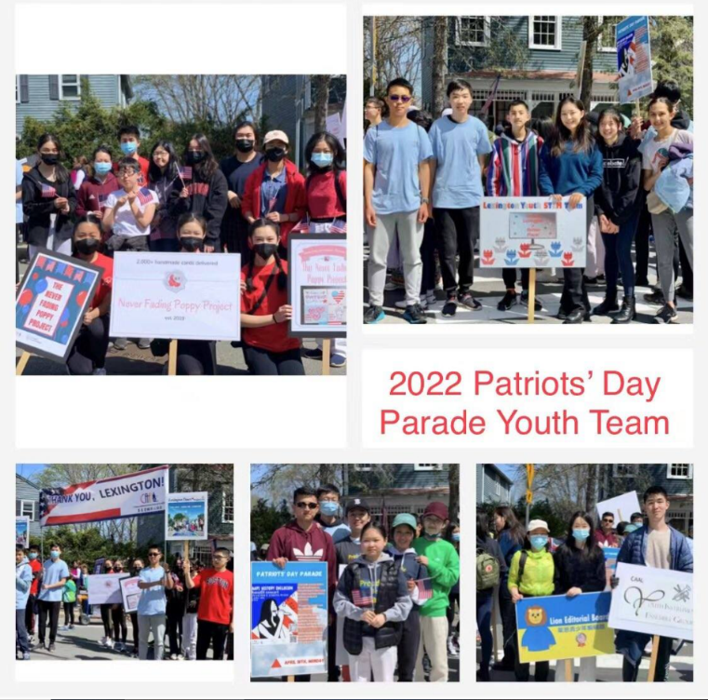
Patriots Day Parade

Slide 19
Candidate forum

Slide 20
Recent Community Impact
In 2022, CAAL has worked with the town and various local and regional organizations on a series of Stop Asian Hate and celebration May AAPI Heritage Month to promote AAPI history, art, food, and a cultural festival.
The 5K Run/walk on Memorial Day, May 30th, attracted over 500 runners to run for unity, solidarity, and belonging.
The Asian Music Festival in June, which CAAL organized with New Moon International, was attended by close to a thousand residents.

Slide 21
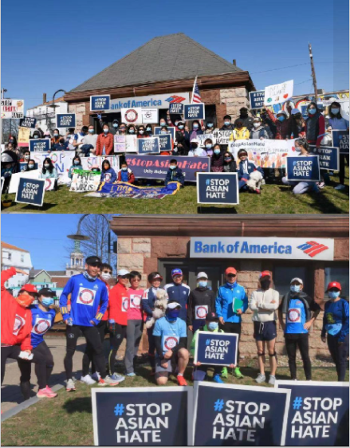
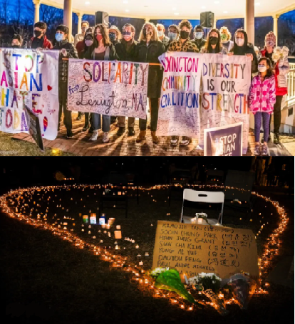
Stop Asian Hate

Slide 22
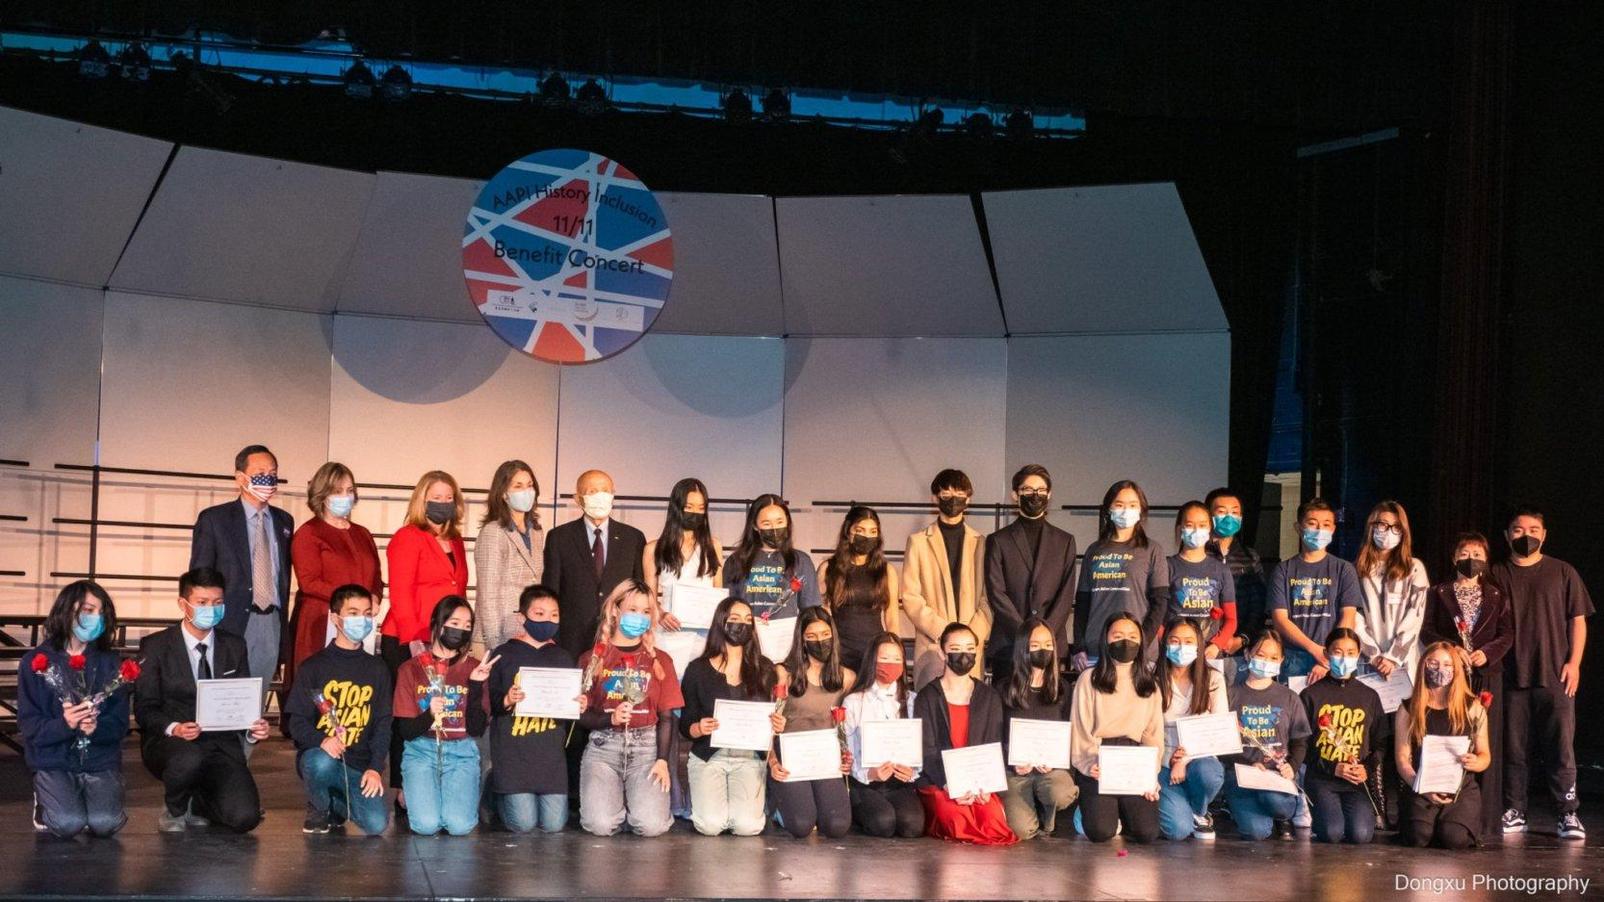
AAPI Concert

Slide 23




AAPI Heritage Month Celebrations in 2022
AAPI Photography Exhibits
AAPI Food Cultures
AAPI 5K Run ‘N’ Walk and Food Festival
AAPI History Celebration

Slide 24
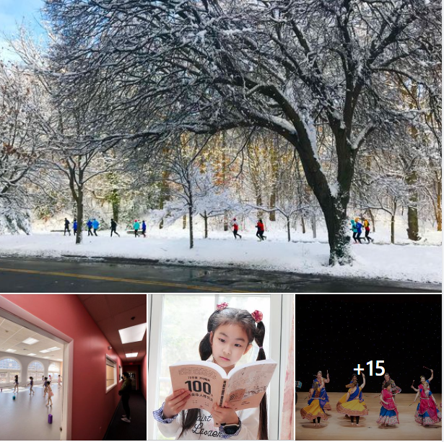
Asian in Lexington – Photography Exhibit in 2022
Video link:
https://fb.watch/fKNcqmjYBH/

Slide 25
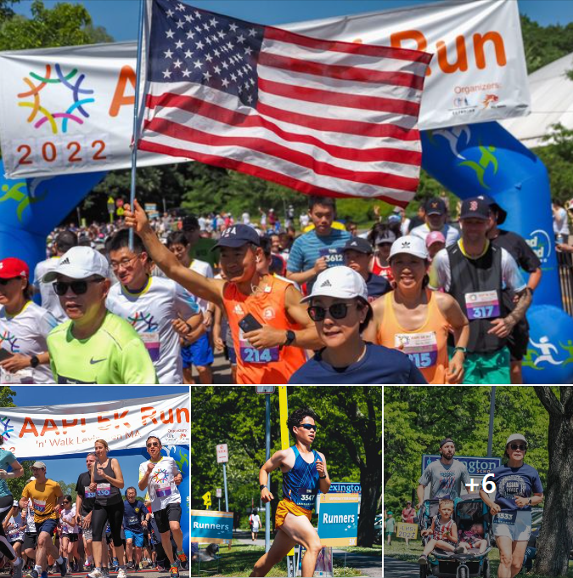
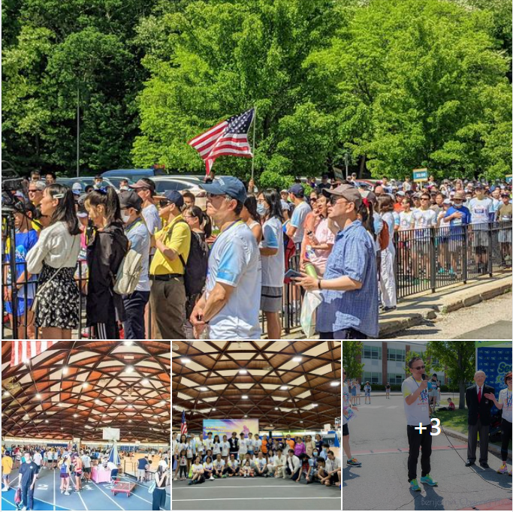
AAPI 5K Run/Walk and Festival in 2022
Video link:
https://www.dropbox.com/s/0esbflh55p5i45e/aapi.5k.2022.MOV?dl=0

Slide 26
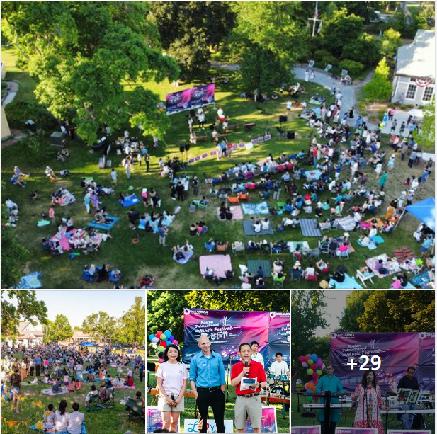
Asian Music Festival
Video link
https://fb.watch/fKMvO9sDPd/
https://fb.watch/fKMARYO2AD/
https://fb.watch/fKMCgj16Qa/

Slide 27
Accomplishments and Awards
CAAL has been recognized as the most impactful town-level community organization in the country! CAAL received the “2022 UCA Outstanding Chinese American Organization Award’ at the United Chinese Americans Convention held in Washington DC.
CAAL’s Youth Programs received the “Certificate of Achievements Award”.

Slide 28
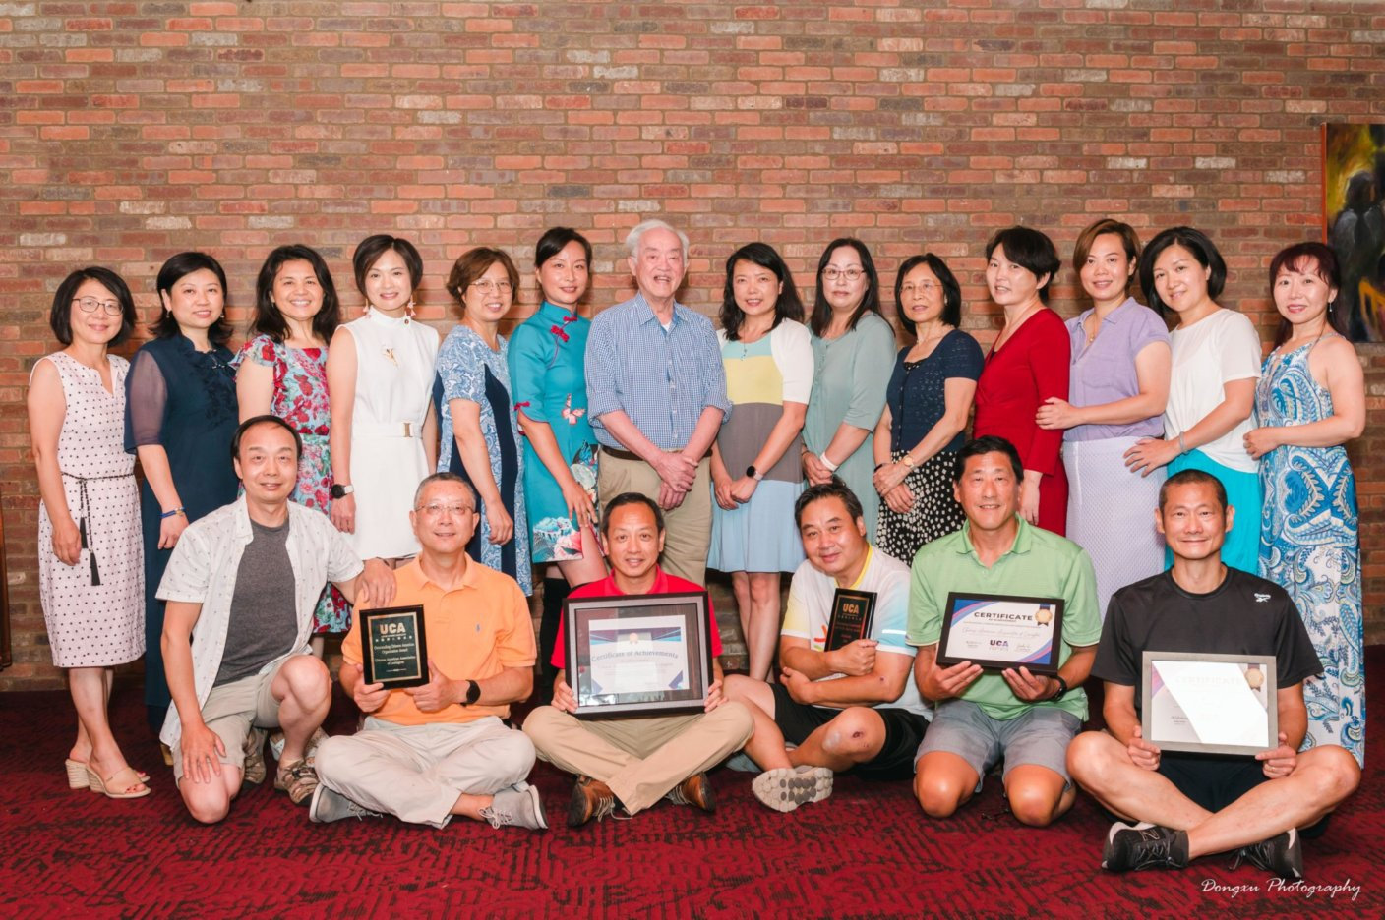
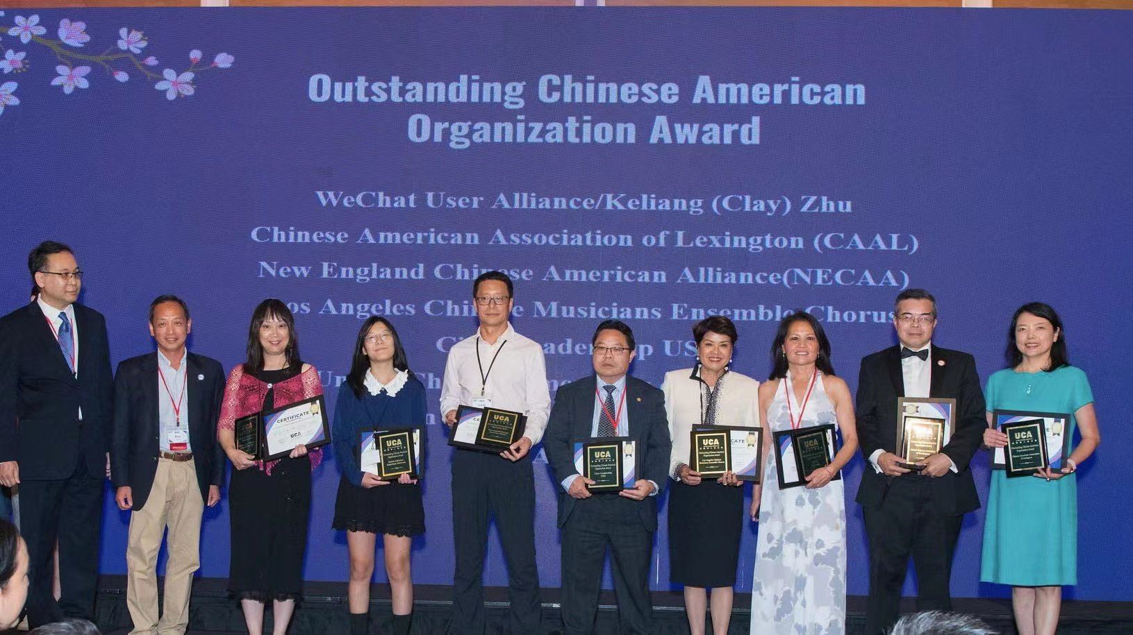
CAAL Received Outstanding Chinese American Organization Award
At UCA Bi-annual Convention in 2022

Slide 29
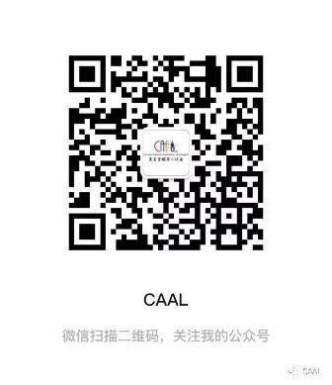
Contact and Follow CAAL
Email us at contact@caal-ma.org
We will add you to community email list and WeChat group.
To know more about CAAL:
-Visit website: www.caal-ma.org
-Follow us on Facebook:@caal1983 and Twitter: @caalsince1983
-Scan the below QR Code via WeChat to follow CAAL news

Slide 30

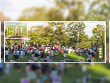


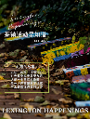

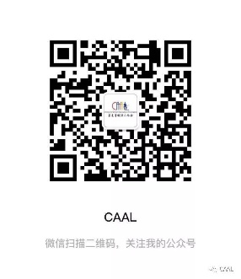


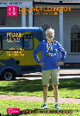






Subscribe CAAL Newsletter and Blogs
1
CAAL English Newsletter
2
Lexington Monthly Happenings (莱镇活动早知道）
3
Discover Lexington – A Bridge to Western Culture (莱镇人文）
4
Read Lexington (书语莱镇）
5
莱了-文艺专刊 Neighbors Gallery (百家长廊）

